Slide 1

Using AI Chatbots to Recommend Restaurants: Data Overview & Models

Slide 2
Presentation Agenda
Our Team
Data Sources
Data Cleaning & Engineering
Descriptive Analysis
Predictive Models

Slide 3
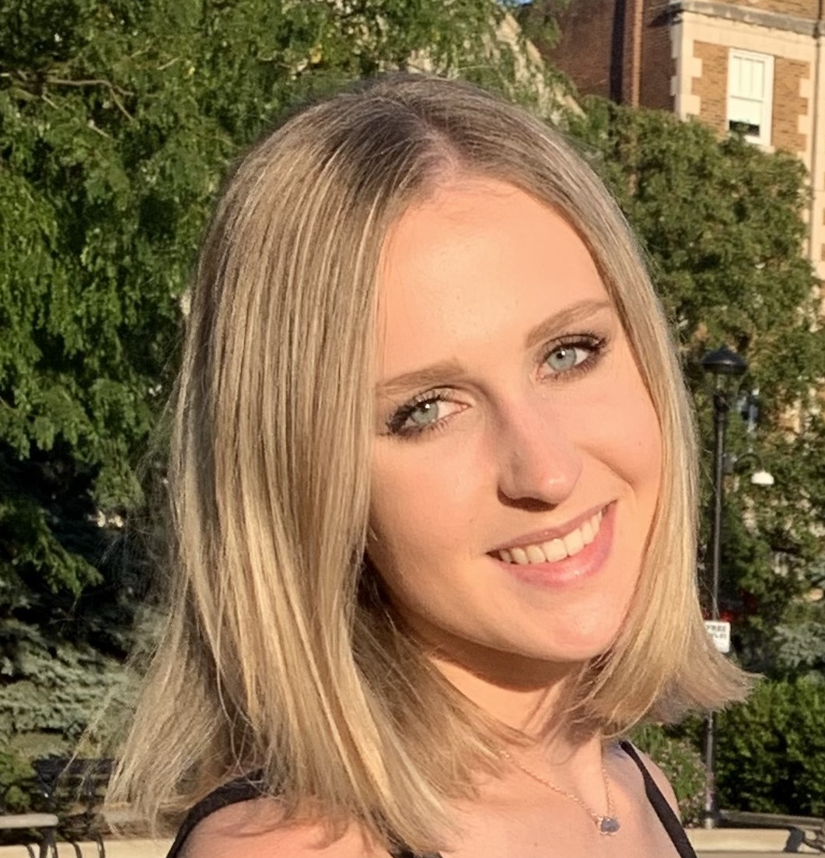
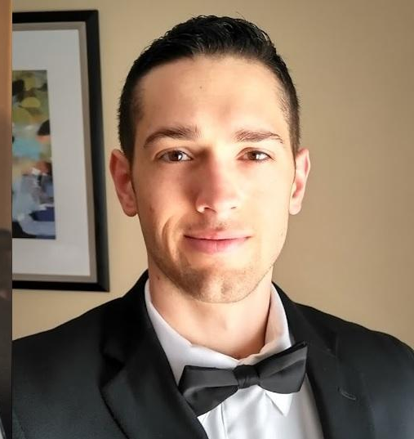

Meet the Team!
Magda Odrowaz
Buffalo Grove, IL
B.S. Kinesiology & Health ‘22
M.S. Business Analytics ‘23
Adam Brobson
Jenks, OK
B.S. Mechanical Engineering
M.S. Business Analytics ‘24
Evan Frank
Bainbridge, OH
B.S. Physics ‘21
M.S. Business Analytics ‘23

Slide 4
Data Source
Our data set was hosted on Kaggle but provided by Yelp.
The data was given in the .json format and was given in a small set of relational tables.

Slide 5
Data Summary
269 restaurants in Philadelphia
56061 total restaurant reviews
At least 15 reviews per user for various restaurants

Slide 6
Data Cleaning/Feature Engineering
From our data set we were able to get business id, reviewer id, star rating, and name of business.

Slide 7
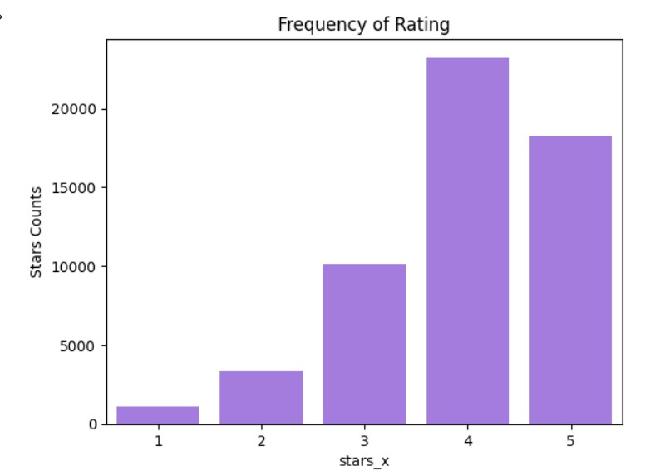
Descriptive Analysis
Most frequently given restaurant rating is a 4 star rating.

Slide 8
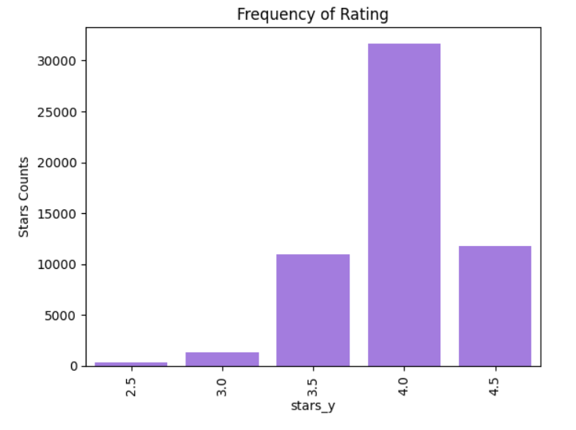
Descriptive Analysis
The stars_y table is the average rating of a Restaurant for a review

Slide 9
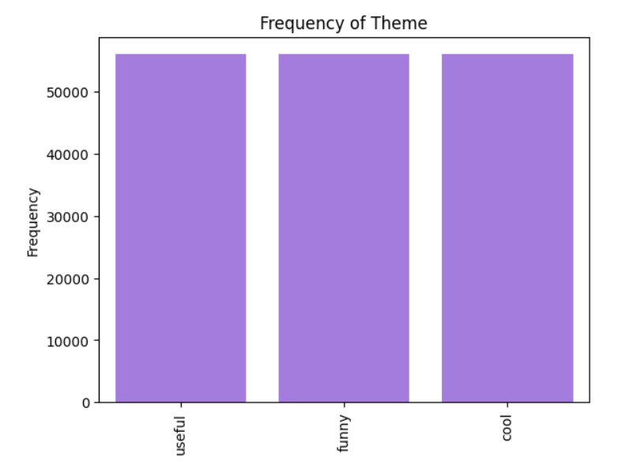
Descriptive Analysis
People use the three main themes are an equal frequency.

Slide 10
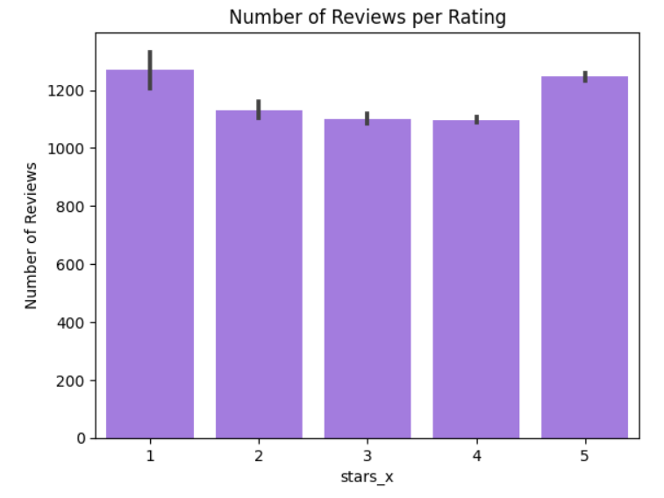
Descriptive Analysis
The Number of people that gave a review for a rating of a company.

Slide 11
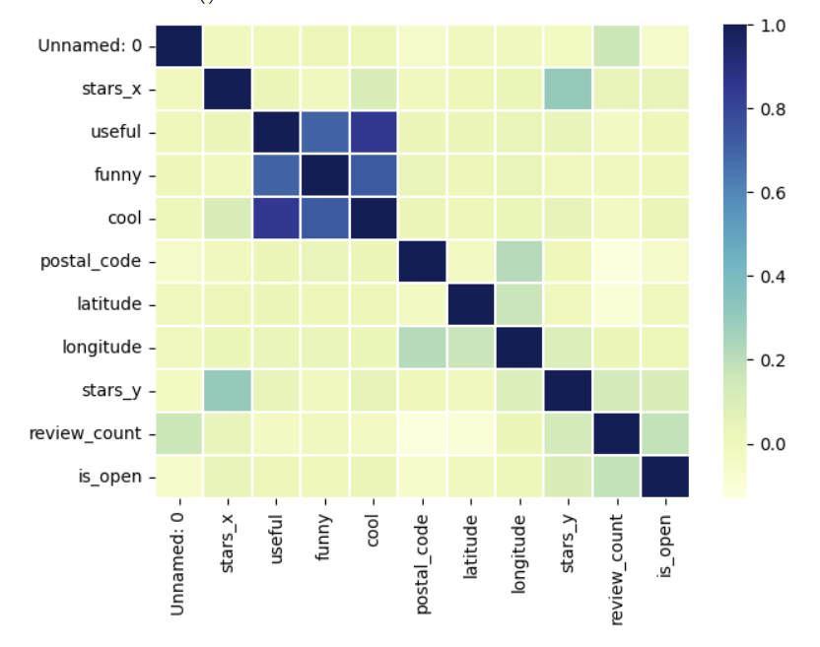
Descriptive Analysis
Theme analysis key words are highly correlated, as expected. Stars_x and stars_y are also somewhat correlated.

Slide 12
ALS Model Deployment
We are only concerned with three fields for our ALS model.
Business ID(or name), User ID, and stars_x.
One of our main next steps is structuring and making this model.
We will assume User ID is available to be entered.

Slide 13
Questions?

